Slide 1
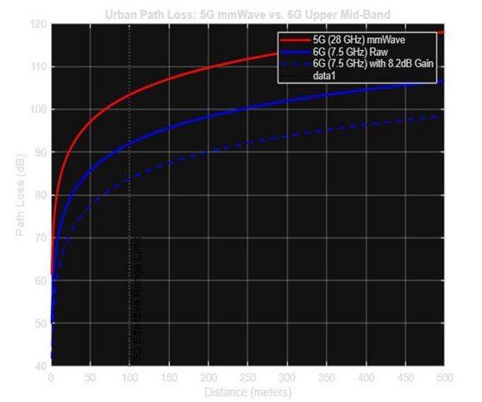
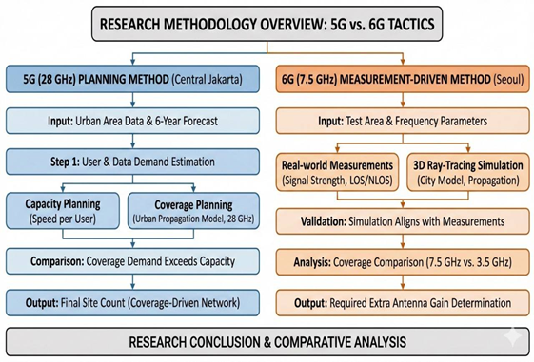

Comparative Analysis of 5G Millimeter-wave densification and 6G Upper Mid-Band Coverage Optimization in Dense Urban Environment
Hassan Aladoughan Ahmed Aldawghan Nwaf Asiri
223014794 223005965 223003096
King Faisal University King Faisal University King Faisal University
Abstract
The transition from 5G to 6G requires rethinking how urban wireless coverage is designed. Current 5G hotspots in dense areas like Central Jakarta rely on 28 GHz mmWave, which delivers high speeds but suffers from severe penetration loss and a coverage range under 100 meters, forcing operators into costly densification with up to 748 gNodeBs for 43.8 km².
6G research shifts toward the 7.5 GHz upper mid-band, which, despite higher path loss than 3.5 GHz, avoids the extreme blockage issues of mmWave. Field tests in Seoul show that with advanced beamforming and an additional 8.2 dB antenna gain, 6G can recover nearly 90% of mid-band coverage while maintaining high capacity without requiring a cell site on every street corner.
III. Experiments
The propagation performance of 5G mmWave (28 GHz) and 6G upper mid‑band (7.5 GHz) was evaluated using path loss and received signal strength metrics. Simulations show that 28 GHz experiences extremely high attenuation, exceeding 100 dB within the first 100 meters, limiting its effective cell radius and requiring hyper‑dense deployment such as the 748 gNodeBs used in Jakarta.
In contrast, the 7.5 GHz signal shows lower attenuation and avoids the severe blockage issues of mmWave, though it naturally covers only 63% of a 3.5 GHz cell. With an added 8.2 dB antenna gain, 6G can reach up to 90% of mid‑band coverage.
RSRP analysis indicates that 28 GHz quickly drops to the “Poor” threshold near 100 meters, while the optimized 7.5 GHz signal maintains “Excellent” to “Fair” quality over significantly longer distances.
Introduction
The transition from 5G NR to 6G introduces a major shift in network planning due to differences in operating frequencies. 5G planning has relied heavily on high-spectrum mmWave (28 GHz) to support eMBB, but in dense urban areas like Central Jakarta, severe blockage and a cell radius under 100 meters require hyper‑dense deployment, reaching 748 gNodeBs for 43.8 km².
In contrast, 6G research focuses on the upper mid‑band (7–24 GHz), with 7.5 GHz evaluated as an IMT‑2030 candidate. Although 7.5 GHz naturally covers only 63% of a 3.5 GHz cell, it avoids the extreme limitations of mmWave. Simulations show that adding 8.2 dB antenna gain enables 6G to achieve coverage comparable to 5G mid‑band while reducing the need for massive site densification.
Distance | 6G :7.5 GHz + 8.2 dB | 6G :7.5 GHz | 5G : 28 GHz
50 m | 77.42 dB | 85.62 dB | 97.06 dB
100 m | 83.74 dB | 91.94 dB | 103.38 dB
200 m | 90.06 dB | 98.26 dB | 109.71 dB
II. METHODOLOGY
This research contrasts 5G and 6G tactics employing two techniques: a planning method for 5G and a measurement-driven method, for 6G
Fig. 2.
IV. BACKGROUND AND RELATED WORK
The deployment of 5G millimeter-wave (mmWave) networks at 28 GHz has revealed a significant reality: in dense urban settings, physics is the primary bottleneck. As established in prior studies [1], these high-frequency signals suffer from extreme attenuation and are easily disrupted by the city’s physical fabric, such as buildings and trees. This limited reach—often less than a 100-meter radius—forces a "coverage-first" planning strategy. The Jakarta case study vividly illustrates this burden, where a staggering 748 gNodeBs were required to cover just 43.8 km². This confirms that for 28 GHz, the sheer number of sites is dictated by the need to fill coverage gaps rather than meeting actual user demand.
B. In response to these challenges, the 6G research community has pivoted toward the 7–24 GHz upper mid-band as a more practical "sweet spot." Experimental data and simulations from Seoul [2] suggest that 7.5 GHz offers a much more resilient signal, particularly when navigating non-line- of-sight (NLOS) urban corridors. While 7.5 GHz does not naturally match the broad reach of the standard 3.5 GHz 5G band, the study proved that the gap is manageable. By integrating an 8.2 dB antenna gain, the 6G signal can effectively serve 90% of the area typically covered by 5G mid-band systems.
C. Despite these insights, there is a clear disconnect in the current literature: 5G densification and 6G propagation are usually discussed in isolation. This research bridges that gap by providing a direct, head-to-head comparison. We evaluate the infrastructure requirements of 5G mmWave alongside the measurement-backed performance of 6G upper mid-band within a single, unified urban framework..
5G Millimeter-Wave (28 GHz) Network Planning
Studied 5G deployment in Central Jakarta, where 28 GHz signals have limited range and are easily blocked.
Forecasted 6‑year user growth and monthly data demand.
Applied two planning approaches
  -Capacity Planning: Estimated sites needed to meet user data rates.
  -Coverage Planning: Used urban propagation models to avoid coverage gaps.
Coverage requirements far exceeded capacity needs, resulting in a hyper‑dense network design
B. 6G Upper Mid-Band (7.5 GHz) Coverage Analysis
Evaluated 7.5 GHz performance through field measurements and simulations in Seoul
Collected real signal strength data in LOS and NLOS urban streets.
Built a 3D city model and validated ray‑tracing simulations against measurements
Compared 7.5 GHz coverage to 3.5 GHz mid‑band and determined the additional 8.2 dB antenna gain needed to match 3.5 GHz coverage.
.
VI. Conclusion
When we set out to compare 5G mmWave with the 6G upper mid-band, we really wanted to see how these technologies hold up in the messy, complex environment of a real city. What we found is that 5G at 28 GHz hits some pretty tough physical limits. Because the signal drops off so sharply—losing over 100 dB in just 100 meters—and gets blocked by almost anything in its path, you’re essentially forced to build an incredibly dense network of towers just to keep things running. It’s a massive logistical and financial undertaking.
On the other hand, 6G at 7.5 GHz feels like a much smarter middle ground. Even though its basic coverage starts at about 63% of what we’re used to with traditional 3.5 GHz towers, that’s a gap we can actually work with. By adding about 8.2 dB of antenna gain, we can keep the signal strong and reliable over much longer distances. It’s a night-and-day difference compared to 5G mmWave, which tends to drop to "Poor" quality the moment you move more than 100 meters away.
At the end of the day, using the 7.5 GHz band for 6G just makes more sense. it gives us the high-speed performance we’re looking for without the headache and massive costs of having to put a cell site on every single corner

